Slide 1
CSCI561 Fall 2018 Week 12 Discussion
Prof Sheila Tejada
Prof Wei-min shen
Prof Ning wang
cs561-l@mymaillists.usc.edu
Prof Sheila Tejada stejada@usc.edu
Prof Wei-min Shen shen@isi.edu
Prof Ning Wang nwang@ict.usc.edu

Slide 5
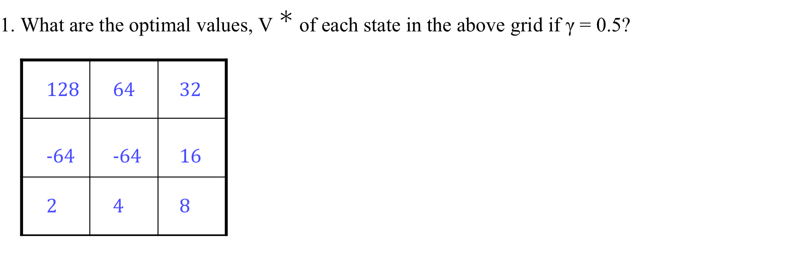
MDP
What are the optimal values and policy?

Slide 6
MDP
2. What are the Q-values for the last square on the second row (i.e., the one without fire)?
Q((1, 2), N) = 16
Q((1, 2), W) = −32
Q((1, 2), S) = 4

Slide 7
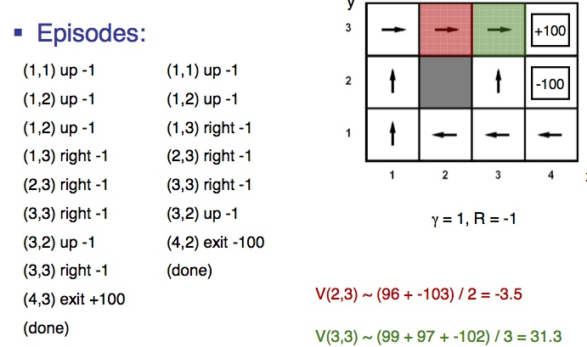
Q-Learning
Q-Learning equation is:
Q(s,a)← (1-⍺)Q(s,a) + ⍺(R(s) + 𝛾 max_{a’}Q(s’,a’))
Example 1
(1,1) up 0
(1,2) up 0
(1,3) right 0
(2,3) right 0
(3,3) right 0
(4,3) exit 100
(done)
Example 2
(1,1) up 0
(1,2) up 0
(1,3) right 0
(2,3) right 0
(3,3) right 0
(4,3) exit 100
(done)
Example 3
(1,1) up 0
(1,2) up 0
(1,3) right 0
(2,3) right 0
(3,3) down 0
(3,2) right 0
(4,2) exit -100
(done)
α=0.5, γ=0.5, R=0 (except two end states)
Q((2,3),R)=0 Q((3,3),R)=0, Q((4,3),exit)=0
After E1
Q((2,3),R)=0 Q((3,3),R)=0,
Q((4,3),exit)=.5*0+.5(100+0.5*0)=50
After E2
Q((2,3),R)=0
Q((3,3),R)=0.5*0+0.5(0+0.5*50)=12.5
Q((4,3),exit)=0.5*50+0.5(100+0.5*0)=75
After E3
Q((2,3),R)=0.5*0+0.5(0+0.5*12.5) =6.25
Q((3,3),R)=12.5
Q((4,3),exit)=75

